Slide 1
SMART HOME SYSTEM
TuringJunior

Slide 2



PROBLEM
TODAY
Our homes are more and more equipped with electronics appliances
Difficulties copping with these devices hence making our daily lives busy trying to manage and control each of them.
Difficult to remote our homes , making it hard to be aware of our home security and statistical state.

Slide 3


SOLUTION
Thanks to the existence of modern technologies like Bluetooth and the internet we can connect almost every electronic device in our homes together and control them remotely through our smartphones with the help of microcontrollers and integrated systems.
Just go, don’t worry

Slide 4


SMART HOME SYSTEM
Our product is your solution
Security is our priority
Make everything prepared before you back
Control everything within your fingertips

Slide 5







OUR SYSTEM IS MODULUS
EACH SMART DEVICES ARE INDEPENDENT FROM EACH OTHER
Application
Control Hub
Smart Devices
User can control the smart devices on their own smart devices
Connect all smart devices
Smart because it can be controlled by user from far with wireless connection

Slide 6


Why our system is great in security

Slide 7
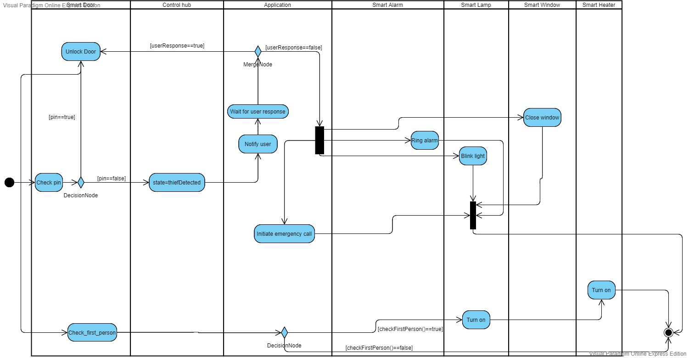

Slide 8
OUR SMART DEVICES ARE SPECIAL

Slide 9
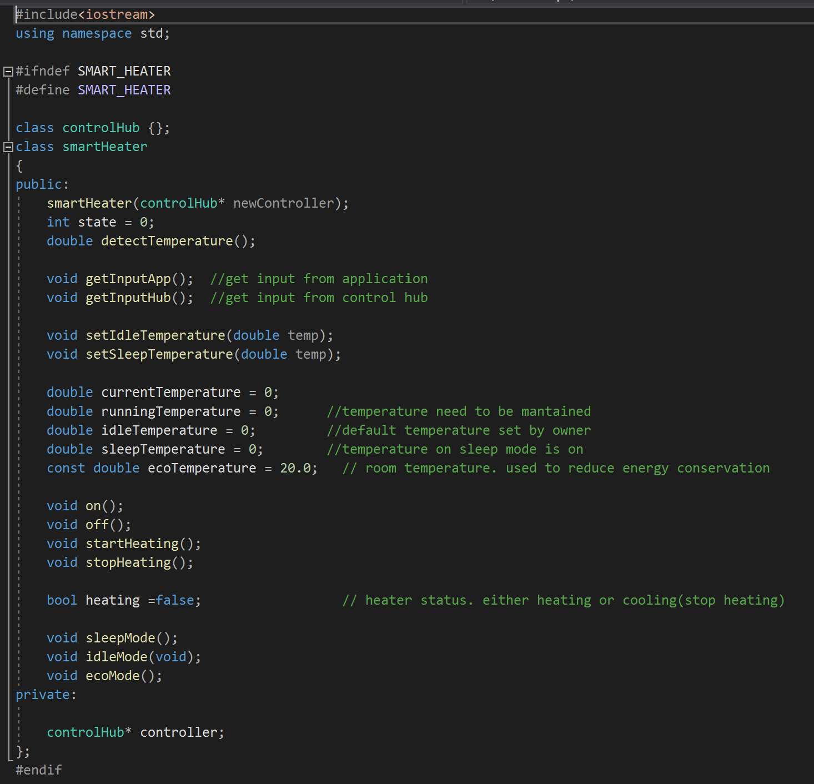
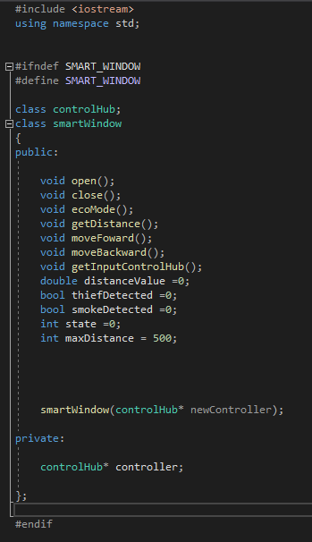
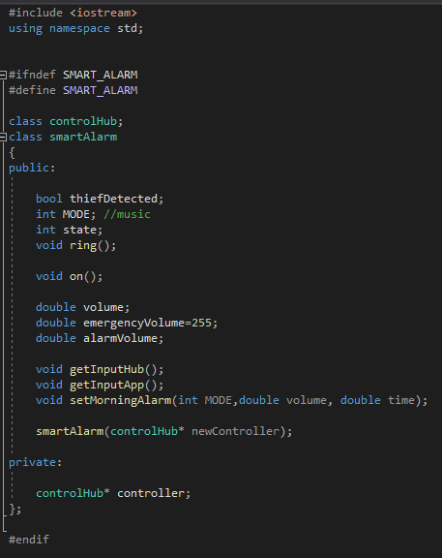
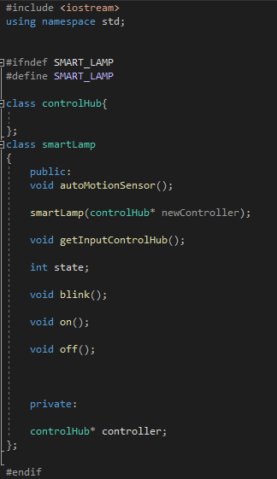
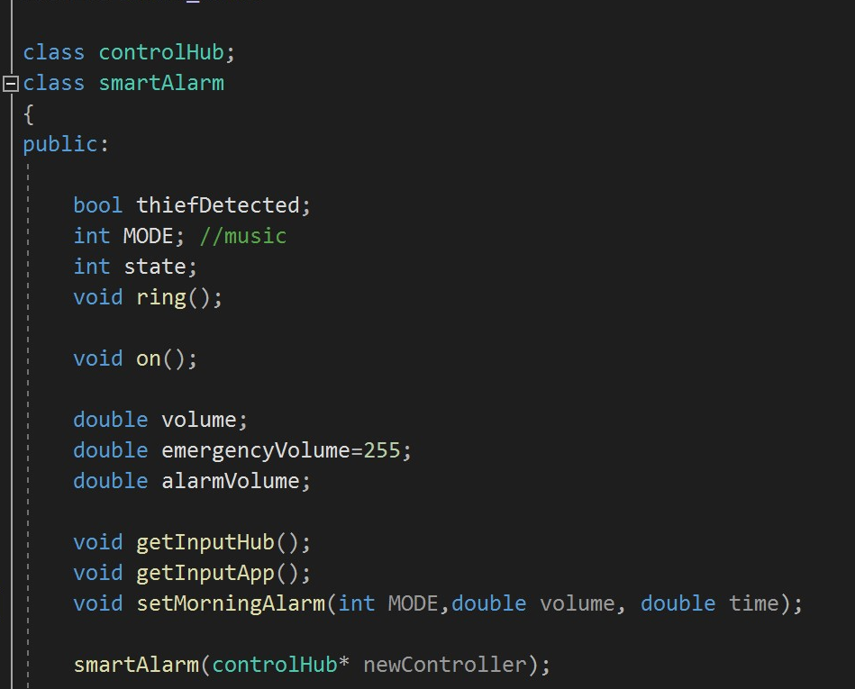

Slide 11
SIMULATION

Slide 12

THANK YOU!
TuringJunior
Phone:
678-555-0134
Email:
turingJunior@team.com
Website:
http://www.turingJunior.smartHome/

Slide 13
OUR TEAM
Always be your solution
Zafirul
Sheikh
Ammar
Developer
Developer
Developer
Hadi
Evrard
Developer
Developer

